Slide 1
Greater Rochester Aqueduct & Subway Project
Getting A GRASP On Our History

Slide 2
The Team
Project Members:
Ye Fon Ho
Andrea De Paula
Dakota Hinchman
Taras Lozowy
Advisors:
Dr. Jessica Leiberman

Slide 3
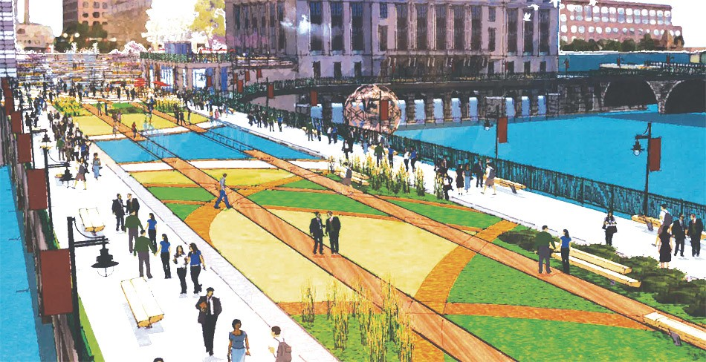
Problem
City Of Rochester has decided to…
Fill in the subway portion of aqueduct with concrete
Tear down the aqueduct to make riverfront community walkway
As a result…
Important history is going to be lost for greater public

Slide 4
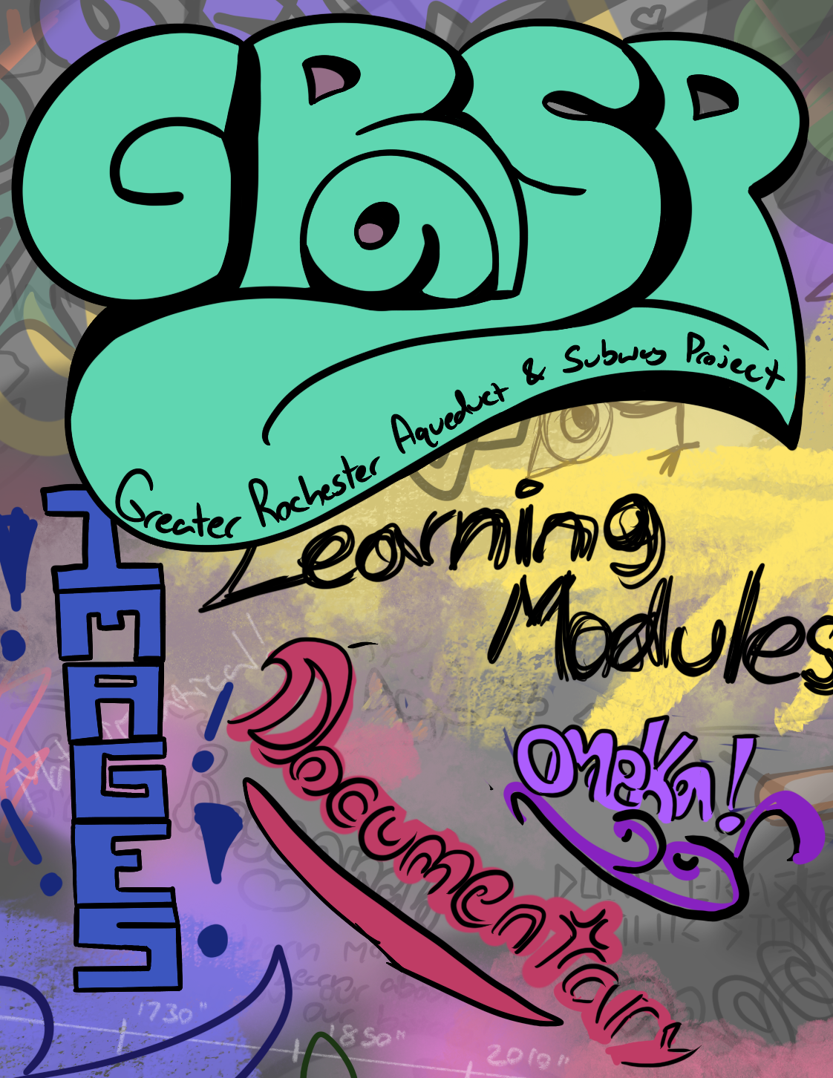
Solution
Collect as much clean, varied data as possible within aqueduct & subway
Future-proof, digital capturing with easy access for general public
Multiple projects presenting the data in different mediums

Slide 5
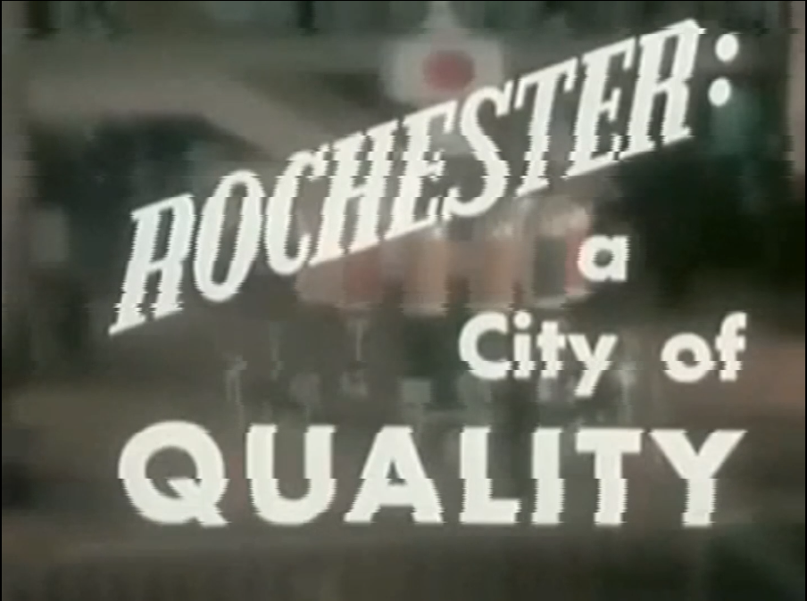
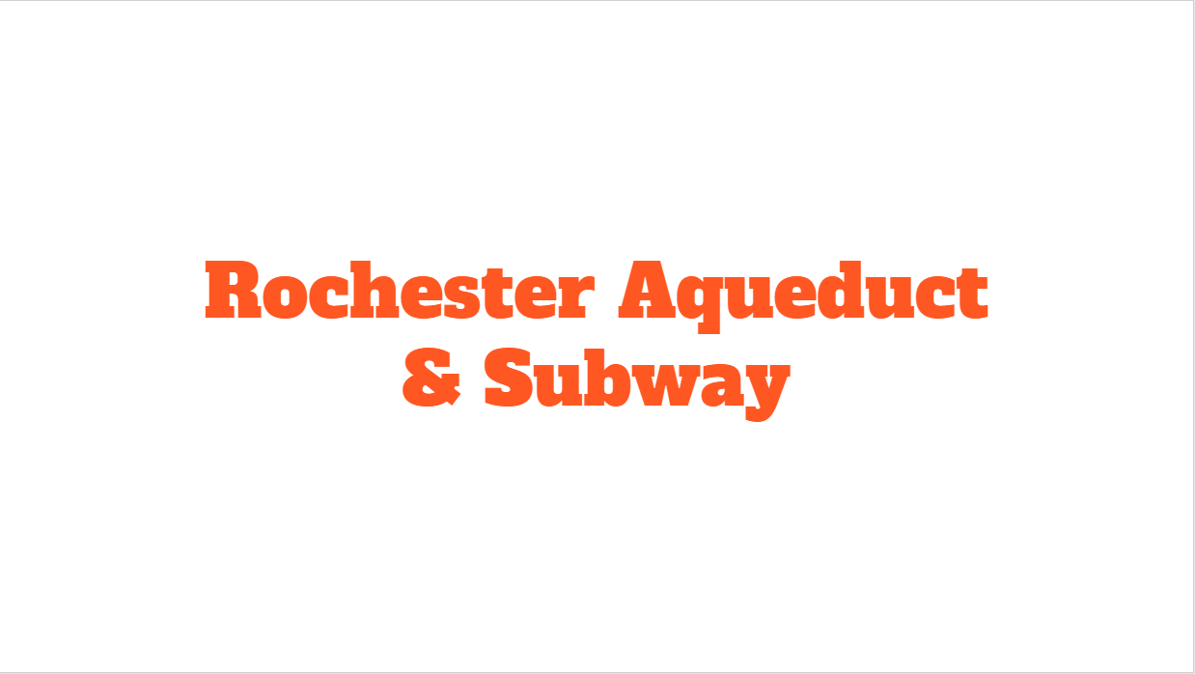
Project Components
GRASP is composed of three sub-projects:
Documentary
OMEKA Database
Learning Module

Slide 6
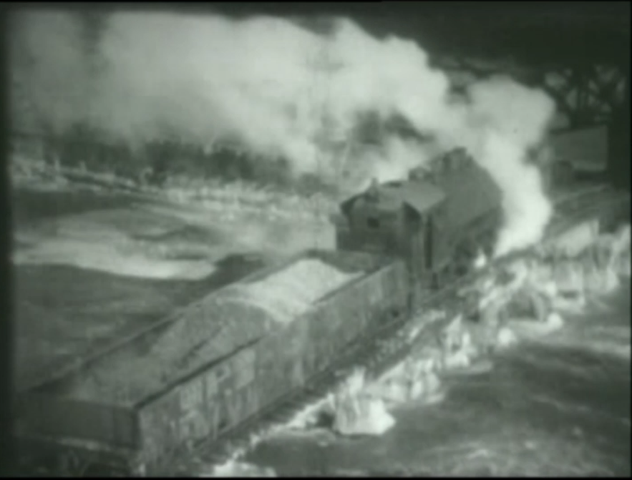
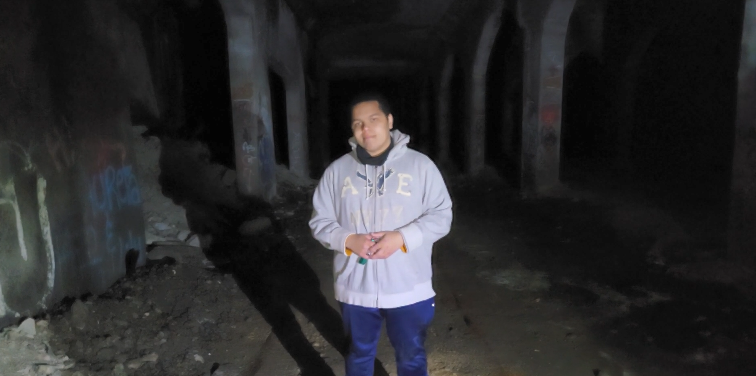
The Documentary
Tackles history of aqueduct, subway, and graffiti.
Discusses ROC The Riverway, GRASP, and the modern public’s perception of the aqueduct/subway.

Slide 7
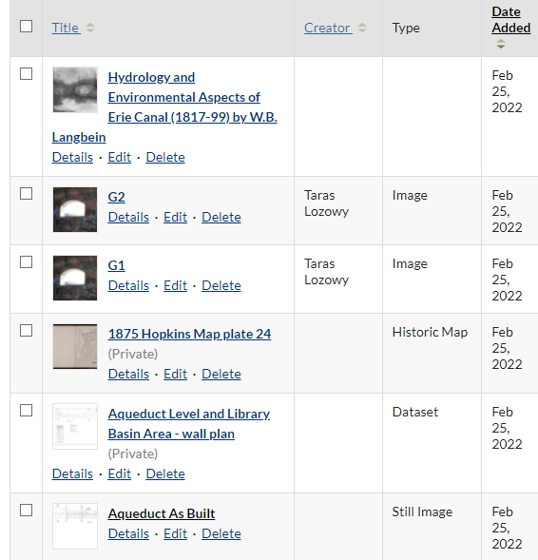
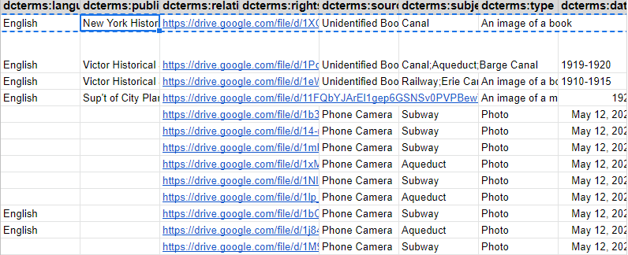
The OMEKA Database
Preserves information on the space in an easily searchable database
Maintains large quantities of data and translates it to be human readable (Tags, collections, dublin core, ect.)

Slide 8
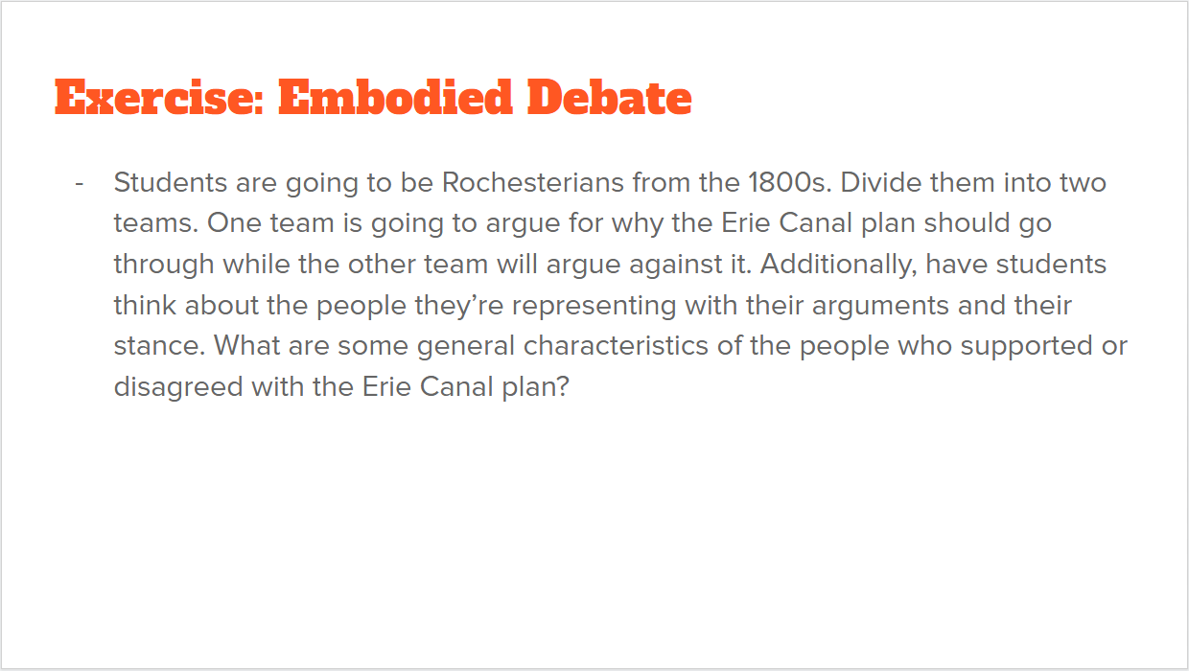
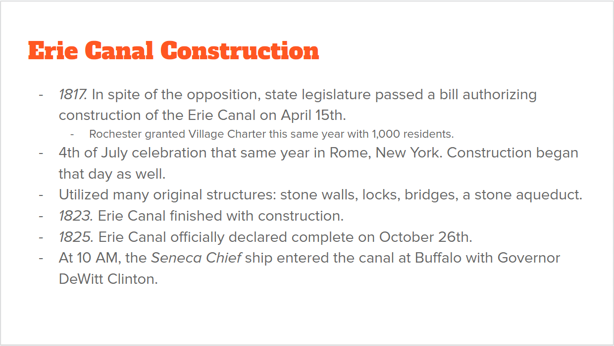
The Learning Curriculum
Utilized Google Slides
2-week curriculum designed for high school students
Covers the history of the Rochester Aqueduct & Subway

Slide 9
Obstacles
OMEKA.
Issues with installation and access permissions.
Time Management.
Documentary & learning curriculum started late.
Scope.
Cutting projects/ideas.

Slide 10
Conclusion
Our goal was to virtually preserve Rochester’s Aqueduct and Subway System, as well as educate on it’s history
Thank you for joining us on our process to do so.

Slide 11
Special Thanks
Rachel Healy.
For assistance on the learning curriculum.
Rebekah Walker
For assistance with omeka.
Anna Rhody & Massimo Greco
For assistance with photos
Jordan Beaupre
For 3D assets and flythrough

